Slide 1
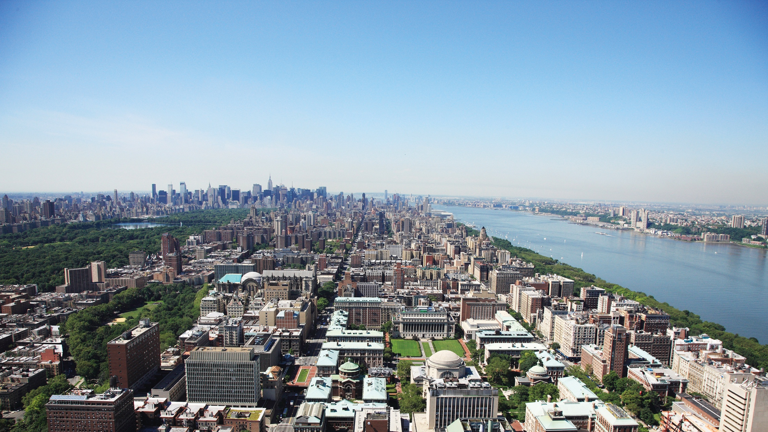
Spatial-Temporal Modeling For Lake Temperature Prediction
Project Presentation for Climate Predication Challenges Course
Group 6: Mohammed Aqid Khatkhatay, Ziwen Ye, Tianxiao Shen
TRANSCENDING DISCIPLINES, TRANSFORMING LIVES

Slide 2
Outline
1. Introduction
Previous Lake Temperature Modeling
Literature Review
2. Problem Definition
3. Methodology
Spatial-Temporal RNN
Attention Mechanism
4. Experiments
Result and Evaluation
Analysis
5. Conclusion

Slide 3
Introduction
Previous Lake Temperature Modeling
Standard Physical Models
E.g. Great Lake Model (GLM)
Shortcomings:
Computationally expensive, prone to overfitting
Incomplete knowledge of physical relationship and approximation in computing process would limit the accuracy of fitting
Deep Learning Models
E.g. Recurrent Neural Network (RNN)
Shortcomings:
Data expensive, while samples are usually sparse
Learning result is inconsistent with physical law
Not able to produce accurate prediction in the scenario that is not trained

Slide 4
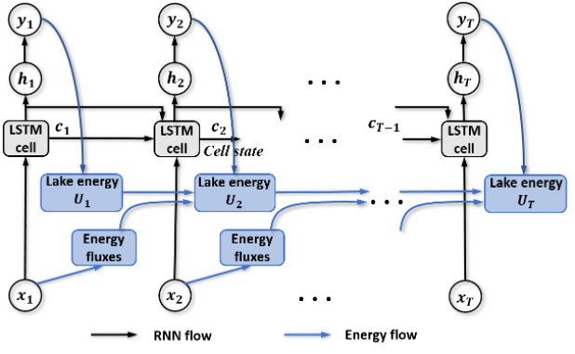
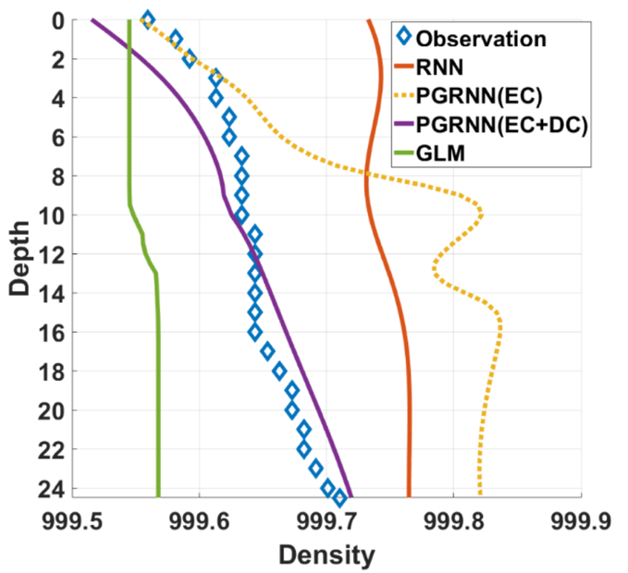
Literature Review
Physical Guided Recurrent Neural Network (PGRNN)
Purposed as a combination of physical model and deep learning
PGRNN is applied for each depth separately
Not able to make a reliable prediction across different depths with given energy conservation information
Thus we are proposing a Spatial-Temporal Model for a better prediction

Slide 5
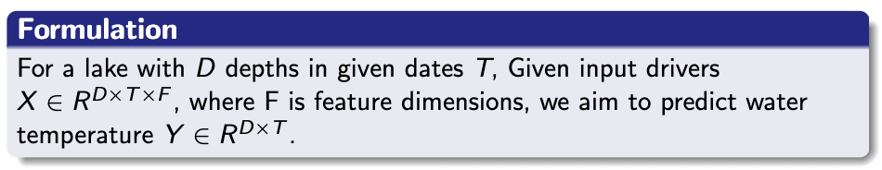
Problem Definition

Slide 6
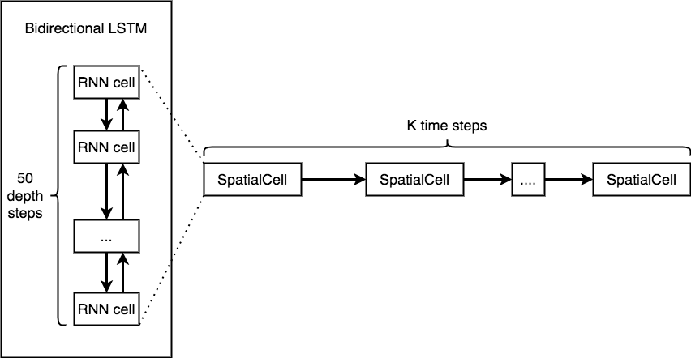
Methodology
Spatial-Temporal RNN
An extra bi-directional RNN layer is applied to represent the energy interaction between different depths in the lake.

Slide 7
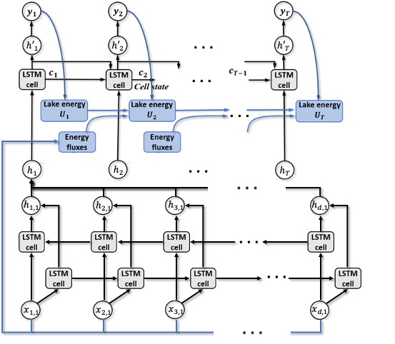
Methodology
Proposed Spatial-Temporal PGRNN Workflow
Compared to previous PGRNN in the reference, the extra layer enables the model to learning more information across different depths.
Chances to reverse the sequence of two layers, creating a Temporal-Spatial PGRNN

Slide 8
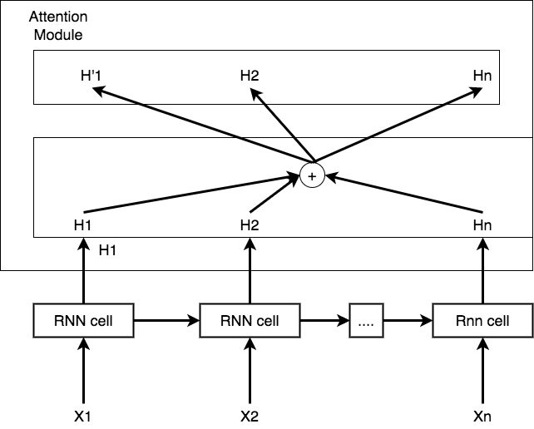
Methodology
Attention Mechanism
Attention Mechanism is a technique that mimics cognitive attention
Enhances some parts of the input data while diminishing other parts
Help to devote more focus to that small but important part of the data.

Slide 9
Experiments
Questions
How does our proposed model perform compare to the PG-RNN?
How does it perform in different experimental settings and conditions?
Does a Spatial-Temporal model differ from a Temporal-Spatial model?
How does the spatial modelling help to improve the performance of the lake temperature prediction?

Slide 10
Experiments
Models and Hyperparameters
Cases
PGRNN
Attention PGRNN (PGRNN with Attention Mechanism)
Spatial-Temporal PGRNN
Temporal-Spatial PGRNN
Spatial-Temporal Attention PGRNN
Optimized Model Hyperparameters
# of RNN Layers: 1
RNN Hidden Dimension: 16
Training Parameters
Batch Size: 64
Learning Rate: 0.01
Optimizer: Adam Optimizer

Slide 11
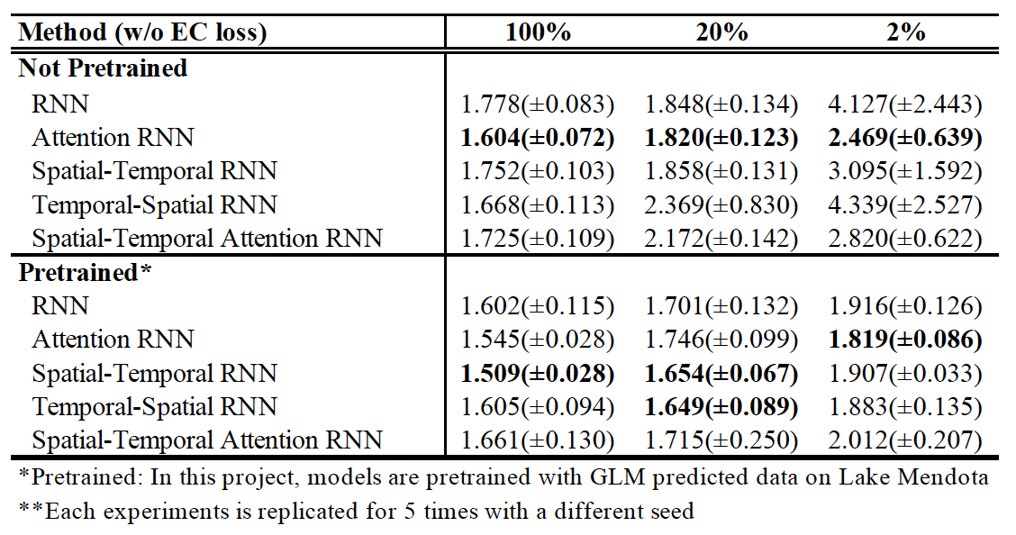
Experiments
Results for RNNs
Models trained with RMSE of temperature (optimal result for each scenario is bolded)

Slide 12
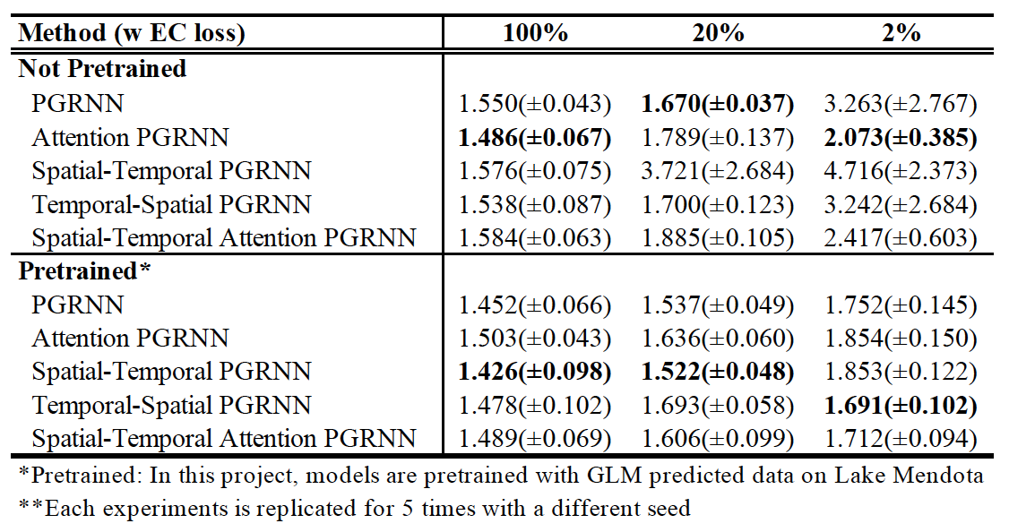
Experiments
Results for PGRNNs
Models trained with Energy Conservation loss

Slide 13
Experiments
In-depth Analysis
From experiments, we can infer that ST-RNN is greater than RNN, but where?
Why ST-RNN is greater than TS-RNN?
Thus we conducted in-depth analysis about model(w ec-loss, w pre-trained) perf.

Slide 14
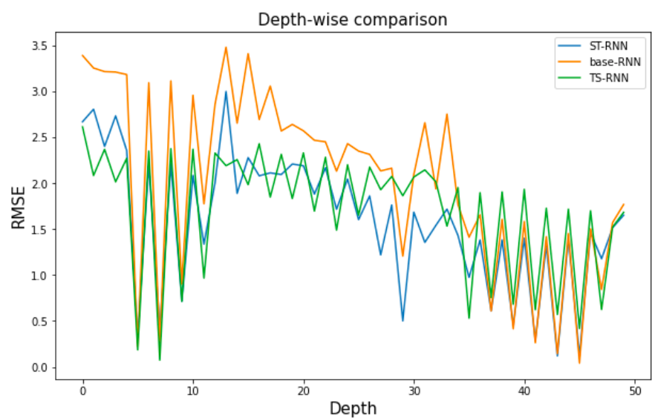
Experiments
Depth-wise Error Analysis
RMSE of different model at different depths

Slide 15
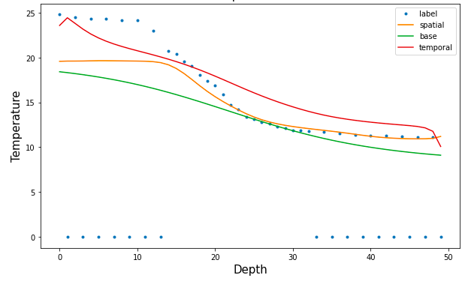
Experiments
Case Study
Prediction from different models and observation data on 7 July 2003
RMSEs:
PGRNN: 12.27
ST-PGRNN: 4.81
TS-PGRNN: 4.15

Slide 16
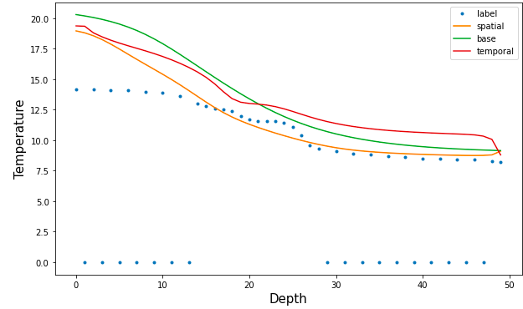
Experiments
Case Study
Prediction from different models and observation data on 14 May 2007
RMSEs:
PGRNN: 7.28
ST-PGRNN: 2.43
TS-PGRNN: 5.89

Slide 17
Conclusions
Based on the comprehensive analysis in our project, we conclude that:
ST-PGRNN outperforms PGRNN by informing depth-wise information to model. The in-depth analysis shows that it greatly improve the prediction accuracy in the intermediate depth.
Attention module seems to be useful in setting without pre-train and ec-loss. It may indicates that it learns latent physical laws in model.
Comparing ST-PGRNN and TS-PGRNN, we find that different ordering of rnn may greatly influence the model learning process.
The bad performance of Spatial-Temporal Attention PGRNN indicates the simultaneous application of the two mechanisms would not lead to a better performance, though they all make better prediction than PGRNN in different settings.

Slide 18
References
Read, JS, Jia, X, Willard, J, Appling, AP, Zwart, JA, Oliver, SK, Karpatne, A, Hansen, GJA, Hanson, PC, Watkins, W, Steinbach, M Kumar, V 2019, ’Process-Guided Deep Learning Predictions of Lake Water Temperature’ https://doi.org/10.1029/2019WR024922
Jia, X, Willard, J, Karpatne, A, Read, J, Zwart, J, Steinbach, MS Kumar, V 2019, Physics guided RNNs for modeling dynamical systems: A case study in simulating lake temperature profiles. https://doi.org/10.1137/1.9781611975673.63
Jia, X., Willard, J., Karpatne, A., Read, J. S., Zwart, J. A., Steinbach, M., Kumar, V. (2021). Physics-guided machine learning for scientific discovery: An application in simulating lake temperature profiles.

Slide 19
Thank you!

